Slide 1


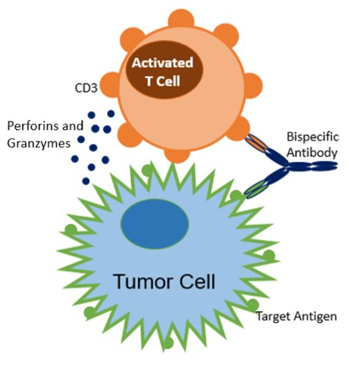
What is the BOSS Program?
The BOSS program is a multidisciplinary program created to transition care to the outpatient setting for patients receiving Bispecific Antibody Step-Up dosing.
The program provides specific nursing guidelines and workflows to help monitor patients for adverse effects related to step-up bispecific dosing, specifically Cytokine Release Syndrome (CRS) and Immune effector cell Neurotoxicity (ICANS).
The primary reason for step-up dosing is to minimize the risk of CRS and ICANS.
Bispecific Outpatient Safe Step-Up Dosing (BOSS) Practice Guide
Nursing Reference Sheet
Upfront Education
Patients will be provided with a Bispecific Patient Education Booklet or Packet depending on if Bispecific is Protocol or SOC.
Patients and Caregivers will attend a mandatory teach to review education materials, required at home monitoring, required length of time they will have to stay within 1 hour of the hospital, and assess need for home VS monitoring equipment (DFCI can loan equipment to the patient if the patient does not have their own equipment)
Teach will be conducted in advance of C1D1 dosing by Shahrier Hossain (or disease specific pharmacist) or Kaitlen Reyes (or ONN/RRN) which will be documented using the following EPIC SmartPhrase: AMBULATORYBISPECIFICTEACHING
Patients will pick up a prescription of Dexamethasone (2 doses) and keep Tylenol on hand. Patient and care giver will be educated to not take any medication unless instructed by MD/NP
What is a Bispecific Antibody?
A Bispecific Antibody (BsAbs) is an engineered protein that can simultaneously bind together a targeted tumor cell and an immune effector cell (T-cells, Macrophages, or Natural Killer cells).
BsAbs that are designed to engage T-cells (CD3) are known as T-cell Engagers
Mechanism of Action?
BsAbs work by binding targeted tumor cells and immune effector cells, which become activated, releasing cytotoxic granules to kill tumor cells.
When cancer cells lyse, they may release proinflammatory cytokines, which can result in cytokine release syndrome.
Why Administer Bispecifics with Step-Up Dosing?
Step up dosing reduces the risk of CRS and ICANS.
Gradually increasing the dose will allow the patient's immune system to adjust, minimizing the risk of severe immune response.
Nursing Considerations
Ideal dosing days: Monday-Thursday, excluding holiday weeks.
Patients will need clearance from a provider to begin step-up dosing.
Ensure premedications are administered per guidelines.
  The NCCN has approved Prophylactic Tocilizumab for use with some Bispecifics to be given on C1D1 prior to Bispecific dosing.
  Prophylactic Tocilizumab might not be appropriate for all patients due to increased risk of Neutropenia and Infection.
Caregivers will be required to monitor the patient at home and assess VS and neuro status; recording this information in patient education booklet/packet provided to them.
  At home monitoring will vary depending on Bispecific administered
  Post administration evening phone will vary based upon Bispecific CRS and/or protocol requirements
  Caregivers are instructed to call or page MD with any abnormal VS or symptoms.
Patients will be required to be seen daily in clinic for duration of Bispecific CRS risk or ICANS risk timeline.
06/2025 KP

Slide 2
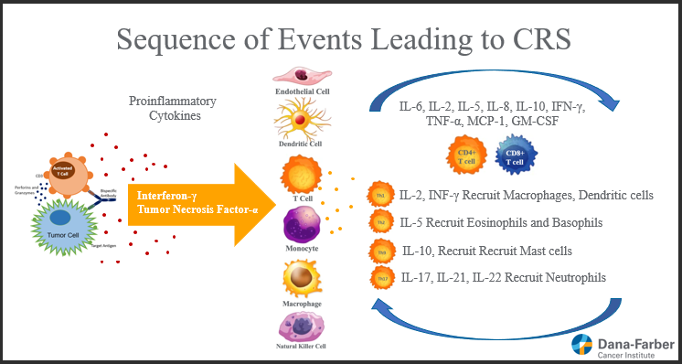
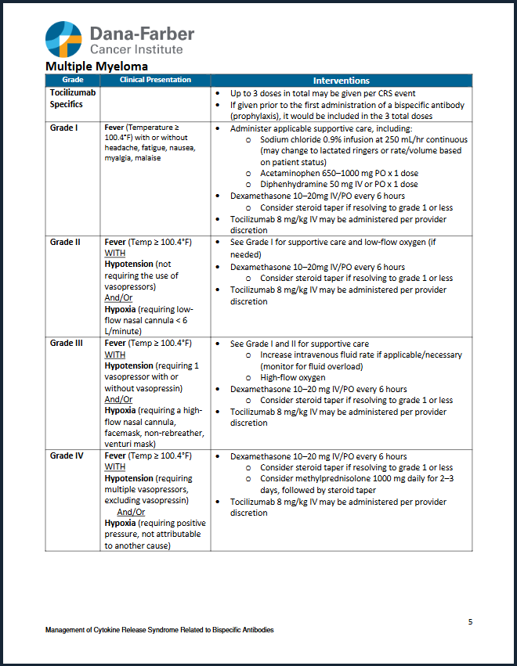
Cytokine Release Syndrome
Bispecific Outpatient Safe Step-Up Dosing (BOSS) Practice Guide
Tocilizumab
Tocilizumab is a recombinant humanized immunoglobulin G1 monoclonal antibody that bind both soluble and membrane bound IL-6 receptors
Mechanism of Action
Inhibits signaling by binding to IL-6 receptors leading to a reduction in inflammatory cytokine production
Administration Guidance
Dosed 8mg/kg with a maximum dose of 800mg
Infuse over 1 hour
Verbalize to pharmacy this is a STAT order
Consent is NOT needed per informed consent policy (4.06)
Side Effects
Infections
Infusion-related reactions / hypersensitivity reactions
LFT abnormalities
Neutropenia, thrombocytopenia, anemia
*If Tocilizumab infusion is indicated & patient condition stable, Administer in clinic prior to ED transfer*
Nursing Reference Sheet
Cytokine Release Syndrome (CRS)
Overactivation of the immune system that can cause Fever, Hypotension, Hypoxia, Capillary Leak Syndrome, and in severe cases Multi-Organ Failure (also known as cytokine storm).
Management of CRS related to Bispecific Antibodies can be found on the DFCI Intranet under Clinical Guidelines.
  Guideline is for commercial products ONLY.
  Follow PROTOCOL GUIDELINES for patients on clinical trial
  Treatment interventions will depend on patient symptoms and the grade of CRS
Early and aggressive supportive care, including timely anti-cytokine therapy, is crucial for reducing the risk of life-threatening CRS
Pertinent Labs to Consider: LDH, Ferritin, CRP, & IL-6
  Consider Sepsis as a differential diagnosis, especially if the patient is neutropenic
  Sepsis Labs: Bld cultures, UA, Urine culture, lactate, chest X-ray
CRS Critical Value VS, per DFCI policy Gen-05
Require Immediate reporting to the provider and documentation
SBP >190 or <90 mmHg
DBP >110 or <50 mmHg
HR >120 or <50 BPM
Oxygen Saturation <90%
Temperature ≥100.4°F
Respiratory Rate <8 respirations/min
06/2025 KP
Notes:
Outpatient MM Bispecific Nursing Education:
CRS s/sx to monitor: slide 12,13 :add link to MM Bispecific CRS clinical guidelines
CRS labwork: slide 29
ICANS s/sx to monitor: slide 18, 19 & 20
What to monitor: slide 22
? Outline RN triage phone call & smartphrase?
?otpt nursing checklist: slide 39?

Slide 3
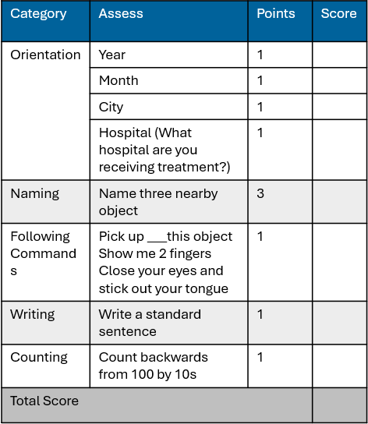
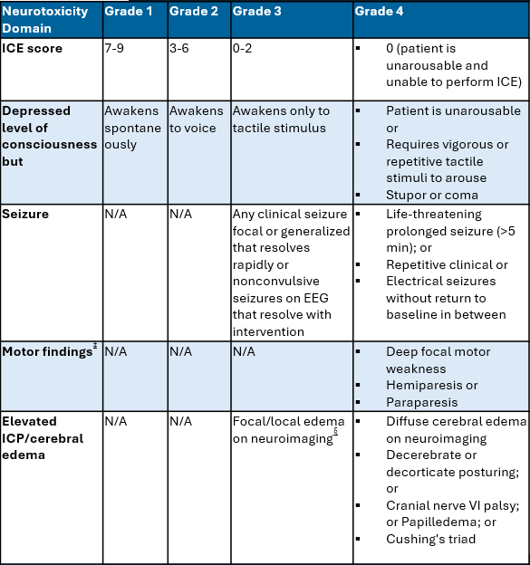
Immune Effector Cell-Associated Neurotoxicity (ICANS)
Disorder characterized by a pathologic process involving the central nervous system following any immune therapy that results in the activation or engagement of endogenous or infused T cells and/or other immune effector cells.
Symptoms can be progressive and may include aphasia, altered level of consciousness, impairment of cognitive skills, motor weakness, seizures, and cerebral edema.
Bispecific Outpatient Safe Step-Up Dosing (BOSS) Practice Guide
Nursing Reference Sheet
Immune Effector Cell Encephalopathy (ICE) Score
ASTCT ICANS Grading
Common Neurotoxic Symptoms:
Headaches are the most common neurotoxic symptoms
Neurotoxicity and/or ICANS occurred in 3 – 14%
Most occurrences are Grade 1 or 2; with rare occurrences of Grade 3 or higher
Supportive Treatment for Neurotoxic Events
Dexamethasone
Acetaminophen
Levetiracetam
Gabapentin
Tocilizumab in select situations
Additional Information
Talquetamab may have cerebellar neurotoxicity such as ataxia
Toclizumab should be used with caution as it may initially worsen neurotoxicity
Neurotoxicity may or may not be accompanied by CRS
06/2025 KP
Notes:
Outpatient MM Bispecific Nursing Education:
CRS s/sx to monitor: slide 12,13 :add link to MM Bispecific CRS clinical guidelines
CRS labwork: slide 29
ICANS s/sx to monitor: slide 18, 19 & 20
What to monitor: slide 22
? Outline RN triage phone call & smartphrase?
?otpt nursing checklist: slide 39?

Slide 4
Post Bispecific Telephone Follow Up Phone Call
Before patient discharged from clinic, Infusion RN will ensure:
  Evening patient phone call is scheduled
  Reinforce with patient & caregiver phone call appointment time
  Remind patient & caregiver of home symptom monitoring schedule and advise home assessment be completed 15 min prior to the scheduled phone call
Phone call should be documented utilizing the following SmartPhrase: .dfcimmboss
  Ensure to use SmartPhrase template as a guide to documentation, document the number of phone call attempts required to reach patient/caregiver, the start and end times of the phone call.
  If unable to reach the patient, the nurse must document patient contact via telephone was unsuccessful and time of the call.
If patient screens positive for signs of CRS or ICANS, the nurse should follow the escalation pathway shown below.
Bispecific Outpatient Safe Step-Up Dosing (BOSS) Practice Guide
Nursing Reference Sheet
SmartPhrase Assessment: sample
SmartPhrase: .dfcimmboss
Patient called on (enter date) at (enter time) for step up dosing follow up. Patient received Cycle 1 Day (enter day), dose (enter number) of (List: Teclistamab, Elranatamab, Talquetamab) today at (enter administration time).
Spoke with (enter name of the patient or person speaking with on the phone). Vitals signs reported by the patient:
Temperature: (enter temperature), Blood pressure: (enter BP), Heart rate: (enter HR)
Oxygen saturation: (enter O2sat), on (drop down options (1) room air, (2) nasal cannula oxygen)
Patient reports dermatologic symptoms (drop down options (1) none, (2) rash, (3) flushing, (4) sweating, (5) other/ free text)
Patient reports respiratory symptoms: (drop down options (1) none, (2) SOB with exertion, (3) SOB at rest, (4) other/ free text)
Patient reports circulatory symptoms: (drop down options (1) none, (2) dizziness/ lightheaded, (3) palpitations, (4) chest discomfort, (5) other/ free text)
Patient reports neurologic symptoms: (drop down options (1) none, (2) increased fatigue, (3) difficulty waking, (4) confusion to name/ date/ location, (5) inability to identify objects, (6) change in writing, (7) difficulty count backwards from 100, (8) other/ free text)
SmartPhrase - Triage
No CRS Grade – reinforce education and instruct patient to return to clinic for scheduled appointment tomorrow.
Grade 1 – instruct patient to stay near the phone the provider will call within the next 30 minutes and nurse notified the provider at _____ time.
Grade 2 no respiratory distress and O2 sat >92 % on room air – instruct patient to go to the emergency department and nurse notified the provider at ____ time.
Grade 2 with respiratory distress and O2 sat < 92% on room air – instruct the patient to immediately call 9-1-1 to be transported to the emergency department and nurse notified provider at____ time.
  Call ended at ()
  Number of attempted calls ()
  Contact via Telephone was not successful
Patient Side Effect Escalation Pathway
Patient Screens + for CRS/ICANS
Nurse will Page MD; MD will call patient
MD will assess patient via phone and advise patient to treat at home or require admission
06/2025 KP
Notes:
Outpatient MM Bispecific Nursing Education:
CRS s/sx to monitor: slide 12,13 :add link to MM Bispecific CRS clinical guidelines
CRS labwork: slide 29
ICANS s/sx to monitor: slide 18, 19 & 20
What to monitor: slide 22
? Outline RN triage phone call & smartphrase?
?otpt nursing checklist: slide 39?

Slide 5
Multiple Myeloma Standard of Care Approved Bispecifics
For Outpatient Step-Up Dosing
Bispecific Outpatient Safe Step-Up Dosing (BOSS) Practice Guide
Premedications for Step-Up Dosing: Administer 1 hour prior to each step-up dose
Dexamethasone 16-20mg PO or IV
Diphenhydramine 25-50mg PO
Acetaminophen 650-1000mg PO
Nursing Reference Sheet
No In-clinic observation is required for Teclistamab, Elranatamab, Talquetamab, or Linvoseltamab
Treatment | CRS Rates - %
Teclistamab | 72.1%
Day 1 – 0.06mg/kg | 43.6%
Day 3 – 0.3 mg/kg | 35.2%
Day 5 to 8 – 1.5mg/kg | 24.2%
Elranatamab | 56.3%
Day 1 – 12mg | 44.5%
Day 3 – 32 mg | 20.2%
Talquetamab | 75%
Day 1 – 0.01mg/kg | 27%
Day 3 – 0.06 mg/kg | 41%
Day 5 to 8 – 0.4mg/kg | 36%
Day 8 to 10 – 0.8mg/kg | 14%
Linvoseltamab | 46%
Day 1 - 5mg | 38%
Day 8 - 25mg | 17%
Day 15 (first full dose) - 200mg | 10%
Timing of CRS | Median Hours/Days (Range)
Teclistamab
Time to Onset | 2 Days (1 – 6)
Duration | 2 Days (1 – 9)
Elranatamab
Time to Onset | 2 Days (1 – 9)
Duration | 2 Days (1-19)
Talquetamab
Time to Onset | 2 Days (1 – 22)
Duration | 2 Days (1- 7)
Linvoseltamab
Time to Onset | 11 Hours from End of Infusion (-1 to 184 hours)
Duration | 15 Hours (1 to 76 hours)
The risk of ICANS is low for Teclistamab (3 – 7%), Elranatmab (3.4%), Talquetamab (7.7%), and Linvoseltamab (8%)
09/2025 KP
Notes:
Outpatient MM Bispecific Nursing Education:
CRS s/sx to monitor: slide 12,13 :add link to MM Bispecific CRS clinical guidelines
CRS labwork: slide 29
ICANS s/sx to monitor: slide 18, 19 & 20
What to monitor: slide 22
? Outline RN triage phone call & smartphrase?
?otpt nursing checklist: slide 39?

Slide 6
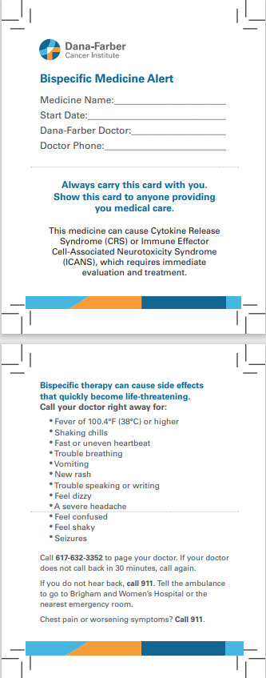
Patient Immunotherapy Wallet Card sample
Bispecific Outpatient Safe Step-Up Dosing (BOSS) Practice Guide
Patient Education
Ensure patients and caregivers have contact information for providers in the clinic (wallet card)
Ensure that patients and caregivers have clear instructions on what to do in case of an emergency and/or who to call in different scenarios
Review Home Monitoring Equipment and Abnormal VS parameters
Encourage oral hydration
Review Infection Prevention measures (hand hygiene, avoid large crowds and people with cold symptoms, influenza vaccination, and prophylaxis medications)
Review CRS and Neurotoxicity symptoms
Nursing Reference Sheet
Critical Values:
SBP <90 (or less than 10% of baseline if pt runs low)
DBP <50
Temp >100.4 F
O2 Sat <90%
NOTE: Critical VS, per DFCI policy GEN-05, require immediate reporting to the infusion RN and provider
When Should the Patient Call 911?
When should the patient call the Provider?
Non-Urgent Symptoms: call during business hours (8am - 5pm ) to speak with the myeloma telephone triage 617-632-4218 option 3.
If after 5pm and on weekends, please call the page operator at 617-632-3352. Ask the page operator to emergently page the provider.
If no response from the doctor within 20 minutes, page again.
Monitor | Call 911 if you notice
Alertness | Will not wake up Suddenly cannot move arms or legs Seizure (uncontrolled shaking or stiffening of body) Sudden change in vision New confusion or more confusion than usual Trouble finding words Change in level of alertness Numbness or tingling Unable to get around Trouble swallowing
Breathing | Not breathing Trouble breathing Sudden chest pain New onset wheezing Coughing up blood
IN AN EMERGENCY
Always call 911.
Caregivers should notify doctor if 911 is called
ALWAYS keep the patient’s treatment wallet card with them
Monitor | Call the cancer care team if you notice
Breathing | Gets winded (short of breath) more easily with very little activity New cough or cough that will not go away Trouble breathing when lying down
Fever or Chills or Infection | Fever greater than 100.4˚F (38˚C) Shaking chills (temperature may be normal) Cold symptoms (runny nose, watery eyes, sneezing, coughing) Pain or burning while urinating
06/2025 KP
Notes:
Outpatient MM Bispecific Nursing Education:
CRS s/sx to monitor: slide 12,13 :add link to MM Bispecific CRS clinical guidelines
CRS labwork: slide 29
ICANS s/sx to monitor: slide 18, 19 & 20
What to monitor: slide 22
? Outline RN triage phone call & smartphrase?
?otpt nursing checklist: slide 39?

